Slide 1
Presents
OO Programming with Java
Namespaces and Java Libraries
Notes:
Namespaces and Java Libraries
Module 7

Slide 2
Objectives
Learn how Java class files are bundled up for deployment
Explore Java packages in more detail and see how they help us organize our code
  And how we can import classes from packages
We will also examine three widely used Java classes: String, StringBuilder and Math

Slide 3
JAR Files
Java system directory structures can be very complicated with lots of small files.
  To simplify the deployment process, Java provides a program that collects all of the class files into one file called a “JAR.”
Code inside a JAR file can be executed as is. The files do not need to be extracted to be usable.
JAR files are used to deploy the libraries used by the development and runtime environments.

Slide 4
JARs and Namespaces
While working with a JAR file, it is possible that some of the classes in it have the same names as some you are creating.
This is called a “namespace clash” and the packaging system helps you deal with it.
  Packages allow you to qualify the simple name of a class.
  Classes with the same simple name and different package names represent different classes.
  com.lq.Test is not the same class as com.othertrainingcompany.Test

Slide 5
Review of Packages
Packages provide a platform-neutral directory system for Java.
Packages allow you to have two different classes with the same name, as long as they are in different packages.
Packages are very useful:
  To make classes easier to find and use
  To organize the project program elements
  To avoid naming conflicts
Notes:
Having classes with the same name might seem like a bad idea: in general, it is. But in Java you will often use packages that have been given to you from another development group, like an open-source project or a vendor. You’ll have no control over how the classes in these packages are named. But it doesn’t matter because the packing takes care of it.

Slide 6
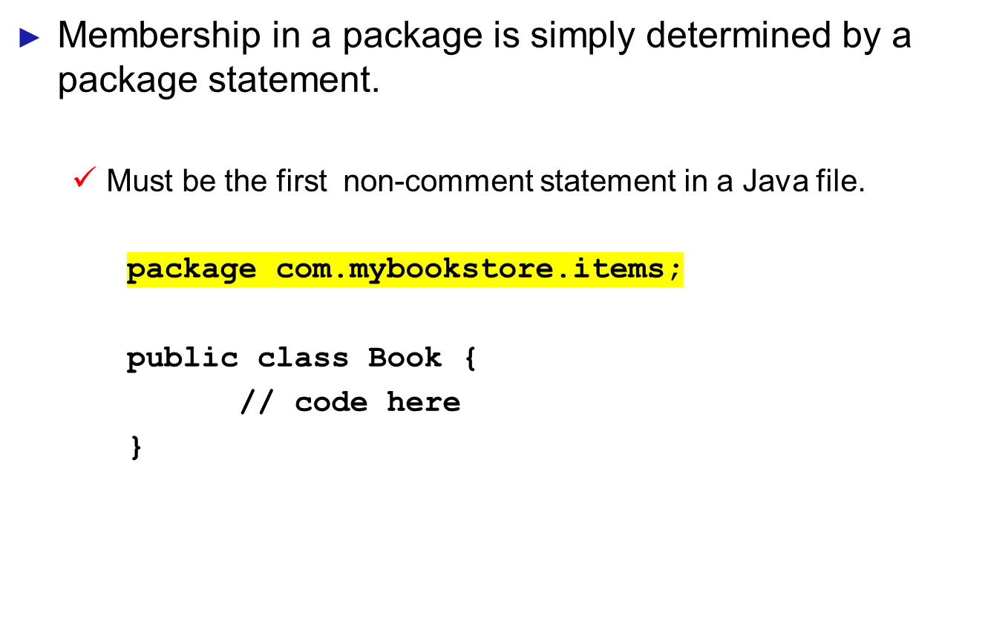
Package Statement

Slide 7
Mapping Packages to the File System
Packages must map onto the file system of the computer where they are being used.
This is accomplished by passing a CLASSPATH variable to the JVM.
  The CLASSPATH variable lists all of the directories where Java packages can be found.
The JVM translates the package statements in your Java code into platform specific statements that are used to locate the class its seeking.
Notes:
In most IDEs you can set the CLASSPATH through a convenient dialogue box.. IDS’s normally do not use the OS’s environment variable CLASSPATH, if it exists.

Slide 8
Creating Packages
Necessary steps to create a package:
  Create a directory with same name as that of the package
  Define all the classes and interfaces that are to be put in the package and save as .java files in the directory created
  Within each source file, declare the package at the beginning of each java file using the package keyword followed by a package name:
package packageName;
Notes:
If one does not use a package statement, the class or interface ends up in the default package, which is a package that has no name.
Generally, the default package is only for small or temporary applications. Otherwise, classes and interfaces belong in named packages.
Note that if you are using an IDE for developing your code, you will not need to make directories in the file system. You will “create” the “directories” in the IDE and the IDE will take care of the file system for you.

Slide 9
Package Naming
By convention, packages are named using a reverse Internet address convention, e.g., learnquest.com would become com.learnquest – in code:
package com.learnquest;
public class Instructor{
// lots of rich, deep complex code here!
}
This is merely a convention. You can name your packages as you see fit …
package but.conventions.are.good.so.dont.do.this;

Slide 10
Importing Packages
Using Package Members
  Only public package members are accessible outside the package in which they are defined.
  To use a public package member from outside its package, one must either:
    Refer to the member by fully qualified class/interface name
    Import the package member
    Import the entire package the member belongs to
import package1[.package2][.package3].className;
Notes:
The general form of an import statement for all the members of the package is :
import package1[.package2][.package3].*;
package1 is the name of the top level package; package2 is the name of the package that is inside the package1 and so on. The star(*) indicates that the compiler can access all classes contained in the package directly.
If by some chance, a member in one package shares the same name with a member in another package and both packages are imported, one must refer to the member by its fully qualified class/interface name.
The import statement should appear before any class definitions in a source file. Multiple import statements are allowed.

Slide 11
The import Statement
A class may access the contents of a java package through the use of an import statement:
package com.learnquest.simple;
import java.io.*; // all classes are available
import java.sql.Connection; // Only Connection
public class DatabaseReader {
Connection conn = new Connection();
}
Notes:
If you need to access a class that is not in the same package as the code that you are writing, then you will need to “point” to the location of the class files. This is done via the import statement.
In the code above, we would have gotten an unresolved reference error on the declaration of the Connection class.

Slide 12
Specifying an import Statement
A given file may include zero or more import statements.
An import statement is placed between the package declaration and the beginning of the class itself.
A single class is imported by using its fully qualified package name.
import java.sql.Connection;
import java.lang.String;
import com.learnquest.instructor.Instructor;

Slide 13
Specifying an import Statement
The contents of an entire package may be made accessible to your class by using a wildcard import statement.
import com.learnquest.instructor.*;
import java.sql.*;
import org.apache.xerces.parser.*;
This statement provides access to all classes in that package.
Notes:
Using the wild card will result in slightly longer compilation times as Java searches the package for the specific classes used in the program. But it will NOT result in an application that runs slower. Java links in the specific classes during runtime.

Slide 14
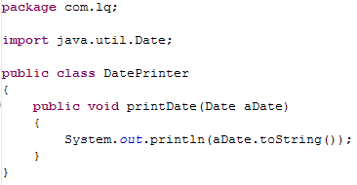
Using Imported Classes
When a class has been imported its name can be used without qualification:
  In this example, Date is resolved to java.util.Date at compilation time.
Notes:
If you elect not to use the import statement, you can “fully qualify” the class when you use it, like this:
public class DatePrinter{
public void printDate(java.util.Date aDate) {
System.out.println(aDate.toString());
}
}

Slide 15
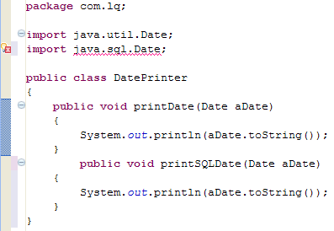
Namespace Clashes
It is still possible to have namespace clashes in Java. Consider the following example:
Notes:
Java has no way of determining which Date class to use.

Slide 16
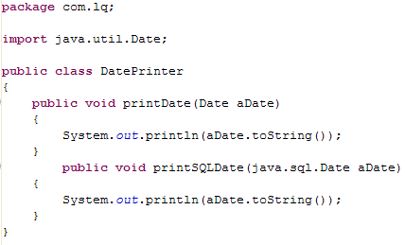
Namespace Clashes
This is resolved by using the fully qualified class name for one of the classes.

Slide 17
Implicit Imports
All Java class files implicitly include the following import statement:
import java.lang.*;
java.lang is a package that supports a set of classes that provide essential Java language and runtime services. This includes:
  String – A class for manipulating immutable character strings
  StringBuilder – A class for dynamically building mutable character strings
  System – A class for interfacing with the operating system
Notes:
The Java runtime system automatically imports three packages:
The default package (the package with no name)
The java.lang package
The current package

Slide 18
The String Class
String is one of the most commonly used classes in Java.
A String object represents an ordered sequence of characters.
Your instructor will show you the online documentation for the String class. As you’ll see, String provides rich support for manipulating ordered sequences of characters.
Notes:
If you’re coming from a procedural language, you may be surprised by the flexibility of the String object. Notice that there is no limit on the String’s length. Regardless of the length of the string you create, Java properly manages the memory storage for you.

Slide 19
Creating String Objects
In the online documentation you’ll see that String provides standard constructors like any other Java class.
Since Strings are so common in programming, Java offers a simplified method for creating Strings.
Anything enclosed in quotes ("") is converted to a String reference and object by Java.
So you can create a String like this:
String userName = "John";

Slide 20
Creating String Objects
Consider this statement:
System.out.println("Hello World");
Java will create a String object for “Hello World” but how will we access it? We can’t because we have no name to use as a reference. So although “Hello World” is a String, it is not reusable and we can’t invoke any String methods on it.
“Hello World” is an anonymous string.

Slide 21
Using Strings
Although it is handy to have a simple way to create String objects, overuse of them can slow the performance of your system .
To help reduce performance problems, Java includes the StringBuilder class.
We will cover StringBuilder after we’ve looked more closely at the String class.

Slide 22
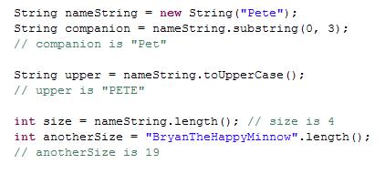
Using a String Object
Here are a few examples of some common String methods:

Slide 23

String Concatenation
Strings can be chained together (concatenated) with a plus sign (+).
The plus sign has two different meanings: one for addition and one for concatenation. Java decides what to do based on the data types of the operands.
Overuse of concatenation can build large numbers of String objects – a huge drain on performance and memory.

Slide 24
Dynamic Strings With StringBuilder
StringBuilder provides dynamic string manipulation without the performance overhead of the String class.
StringBuilder nameBuffer = new StringBuilder("John");
nameBuffer.append(" ");
nameBuffer.append("Richard");
nameBuffer.append(" ");
nameBuffer.append(" ");
nameBuffer.append("Cornwell");
System.out.println(nameBuffer.toString());
StringBuilders must be converted to Strings before they can be printed

Slide 25
The Math Class
The Math class provides useful functions for operations beyond those provided by the basic operators like +, -, etc.
Your instructor will show you the online documentation for the Math class.
Because Math contains static methods, you never instantiate it. To use Math methods simply use the class name followed by the method you want to access.

Slide 26
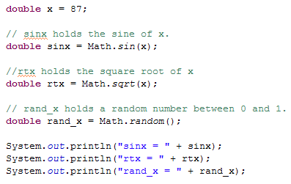
Math Class: Example
The output generated by running the example would be:
    sinx = -0.8218178366308225
    rtx = 9.327379053088816
    rand_x = 0.416779136227027

Slide 27
Summary
An Object is a collection of attributes and methods treated as a single unit.
Objects are created using the new operator.
A package is a collection of different related classes.
The CLASSPATH is an environment variable that tells the compiler where to search for packages.
To manage string operations, Java provides two in-built classes: String and StringBuilder.

